Slide 1









WORKSHOPS
Build Interactive LLM Applications Using OpenAI's Assistants API
Zero Shot Labs x San Francisco AI User Group
Daryle Serrant
Data Scientist & ML Consultant
byteSolid Solutions

Slide 2


During this workshop you will…
Learn core concepts of OpenAI Assistants
Develop a functional AI assistant using the Assistants API
Learn the end-to-end process, from creating Threads to triggering responses and managing Runs

Slide 3




Prerequisites
1
OpenAI API Key
Basic familiarity with Python and Google Colab
2
Basic familiarity with Prompting / Large Language Models (LLMs)
3

Slide 4
Table of Contents / Agenda
1
Tech Overview [20 Minutes]
2
Hands-on Practice [20 Minutes]
3
Final Quiz

Slide 5


Tech Overview

Slide 6
What are Assistants?
AI that leverages OpenAI’s language models
Accesses diverse tools for various tasks
LLM Applications can be customized using Assistants
Notes:
What are Assistants?
Purpose-built AI that leverages OpenAI’s language models
Accesses diverse tools for various tasks (running code, reading files)
Startups and Businesses can customize their LLM Applications using Assistants, incorporating distinct personality traits and functionalities to meet specific business requirements

Slide 7
Why OpenAI Assistants?
Efficient Development: Leverage pre-built models and tools
Personalized Interaction: Guide the personality of the Assistant and define its goals
Enhanced Results: Access multiple tools at once
Notes:
Why use OpenAI Assistants?
Assistants enable efficient development, personalized interactions, and versatile functionality in LLM Applications.
Efficient Development: Assistants leverage pre-built models and tools, cutting down development time and resources.
Personalized Interaction: Use parameters to guide the personality of the Assistant and define its goals.
Enhanced Results: Assistants can access multiple tools at once, amplifying applications' capabilities

Slide 8
Objects
Assistant: Use OpenAI models and tools
Thread: Stores Messages and fits content within LLM context window
Message: Text, images, files stored on Thread
Run: Invokes Assistant on Thread
Run Step: Provides steps Assistant took during Run
Notes:
Assistant - Use OpenAI models and calls tools* to build impactful LLM apps
Thread - Stores Messages and handles truncation to fit content into a model’s context
Message - (text, images, files) Messages are stored as a list on the Thread
Run - Invocates an Assistant on a Thread by calling relevant tools. Upon Run, Messages are appended to the Thread.
Run Step - Provides steps the assistant took as part of a Run
*tools enhance an Assistant's functionality, offering a range of capabilities from executing code to retrieving knowledge

Slide 9
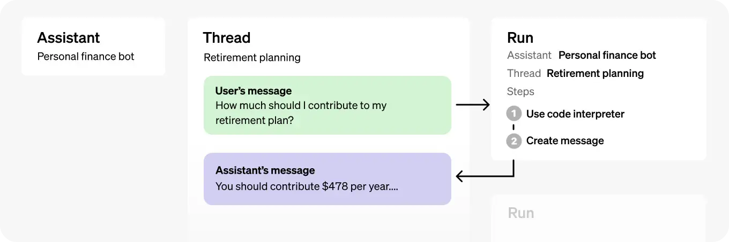
Object Relationships

Slide 10
Project Overview
Build an OpenAI Assistant using Threads, Messages, and File Retrieval.
Install OpenAI library
Create an Assistant
Create a Thread
Add a Message to the Thread
Run the Assistant
Output OpenAI Assistant’s response
AI Assistants with Files
Notes:
Project Overview
Today, we will build our own OpenAI Assistant in Python using Threads, Messages, and File Retrieval.
Install OpenAI library
Create an Assistant
Create a Thread
Add a Message to the Thread
Run the Assistant
Output OpenAI Assistant’s response
AI Assistants with Files
First, let’s review Assistant Tools, Threads, Messages, and Runs in more depth

Slide 11
Assistant Tools
Functionalities or features that the AI Assistant can leverage:
Code Interpreter: Iteratively run code
Knowledge Retrieval: Retrieve content from uploaded files
Custom Function Calling: Execute custom functions
Notes:
Assistant Tools
Tools refer to specific functionalities or features that the AI Assistant can leverage, such as:
Code Interpreter: Enables your Assistant to iteratively run code to solve coding and math problems
Knowledge Retrieval: Enhances the Assistant's knowledge by retrieving relevant content from uploaded files
Custom Function Calling: Enables the Assistant to execute custom functions solely based on their descriptions.
These tools can offer diverse capabilities and functionalities, enhancing the AI Assistant's performance and expanding its range of tasks.

Slide 12
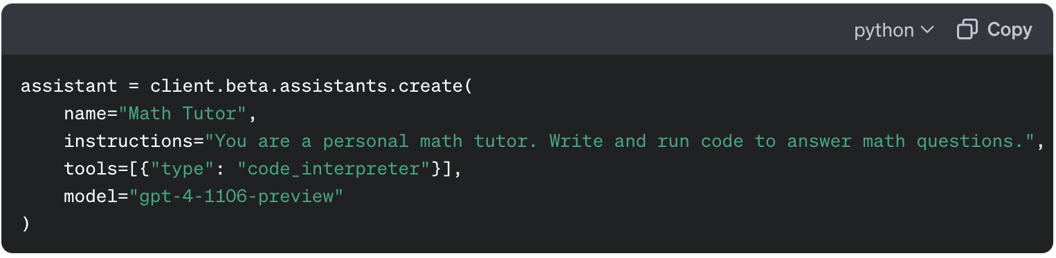
Assistant Tools
Notes:
Defined within the Assistant Object upon its creation
In this Workshop, we will use Code Interpreter and Knowledge Retrieval

Slide 13
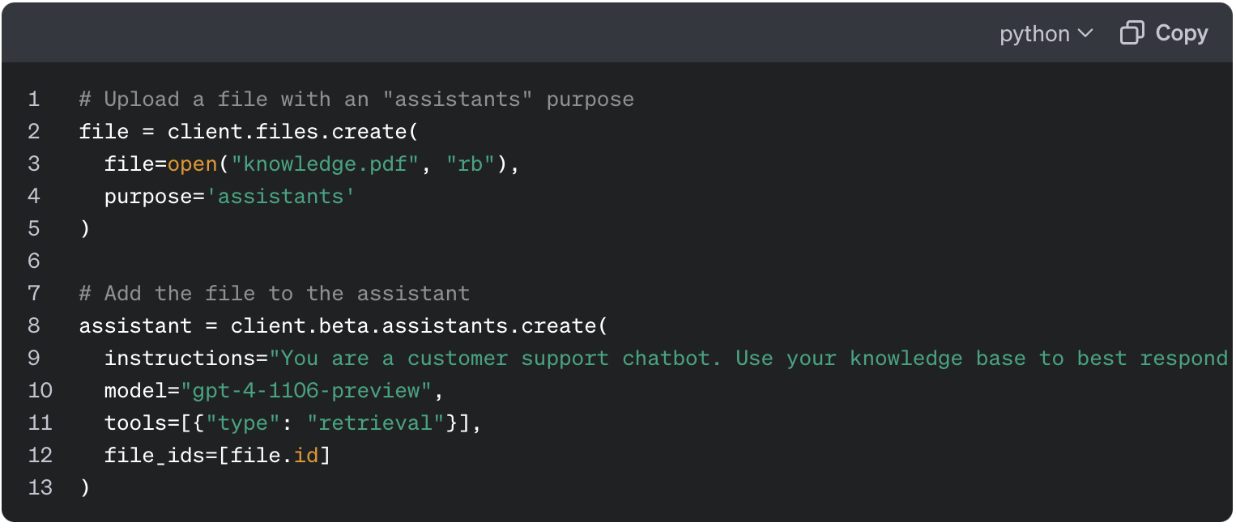
Knowledge Retrieval
Uploading files for Knowledge Retrieval

Slide 14
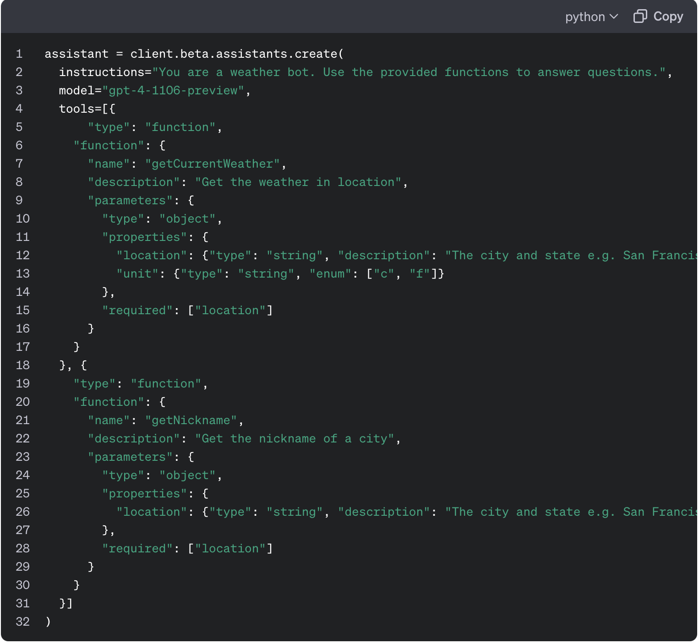
Custom Function Example
Notes:
Describe the functions and Assistants will intelligently figure out which ones to call with their arguments

Slide 15
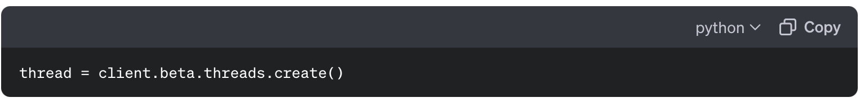
Threads
Represents conversation sessions between an Assistant and User.
Stores and manages Messages
Ensures content fits inside model context window via truncation*
Notes:
Notes on Threads
Representation of the conversation sessions between an Assistant and User.
Threads store and manage Messages, ensuring that content fits into the model's context window through automatic truncation*

Slide 16
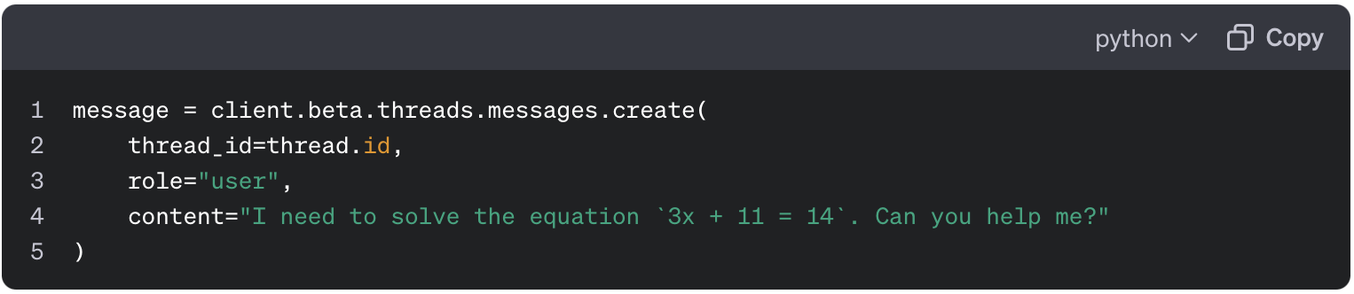
Messages
“Content” can be text, images* or files created by an Assistant or a User.
Specifying thread_id stores messages in thread in reverse chronological order.
*Not yet supported but images can be passed and processed via Knowledge Retrieval tool
Notes:
Notes on Messages
“Content” can be text, images* or files created by an Assistant or a User. In this Workshop we will use text content.
By specifying the thread_id, Messages get stored onto the Thread in reverse chronological order

Slide 17
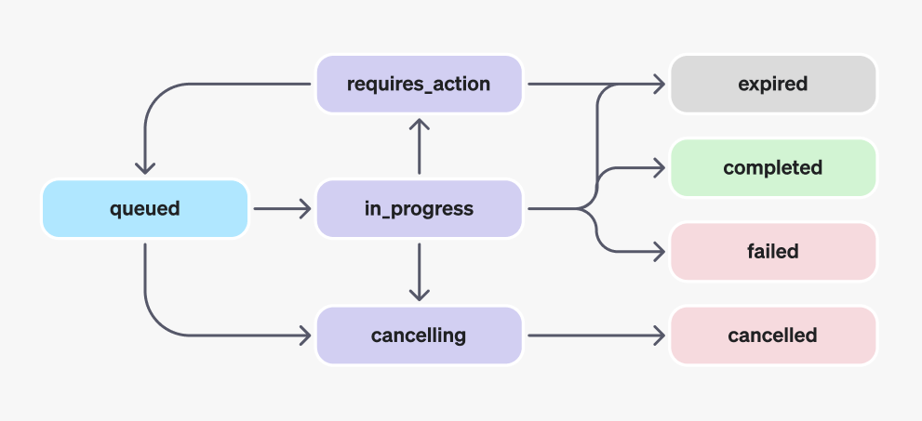
Run Lifecycle
Run Objects and their various potential states.
Threads are locked when Runs are in_progress
New messages can’t be added
New runs cannot be created
🔒
Notes:
Run Lifecycle
Run objects and their various potential states
Thread Locks:
When a Run state is in_progress,the Thread is locked.
New Messages cannot be added to the Thread
New Runs cannot be created on the thread

Slide 18
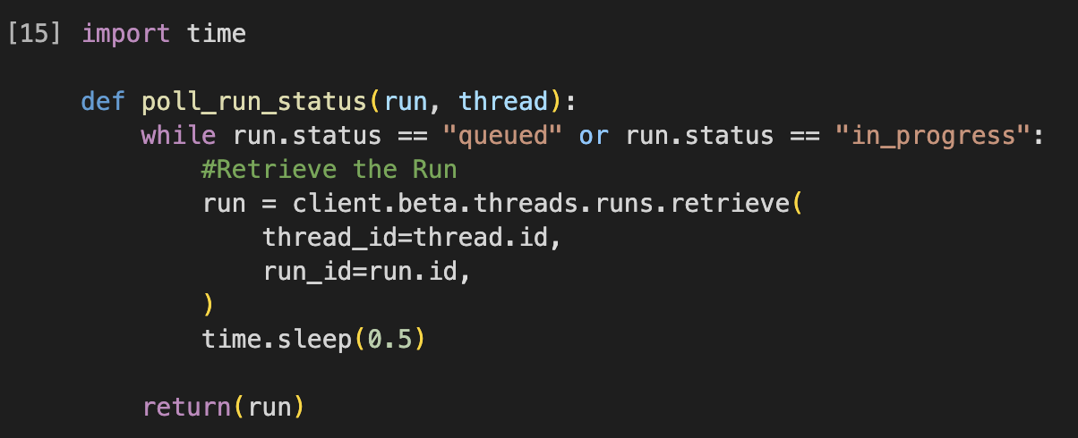
Run Lifecycle
To know when the Assistant has completed processing, poll the Run in a loop.
Notes:
Run Lifecycle
To know when the Assistant has completed processing, we can poll the Run in a loop.

Slide 19
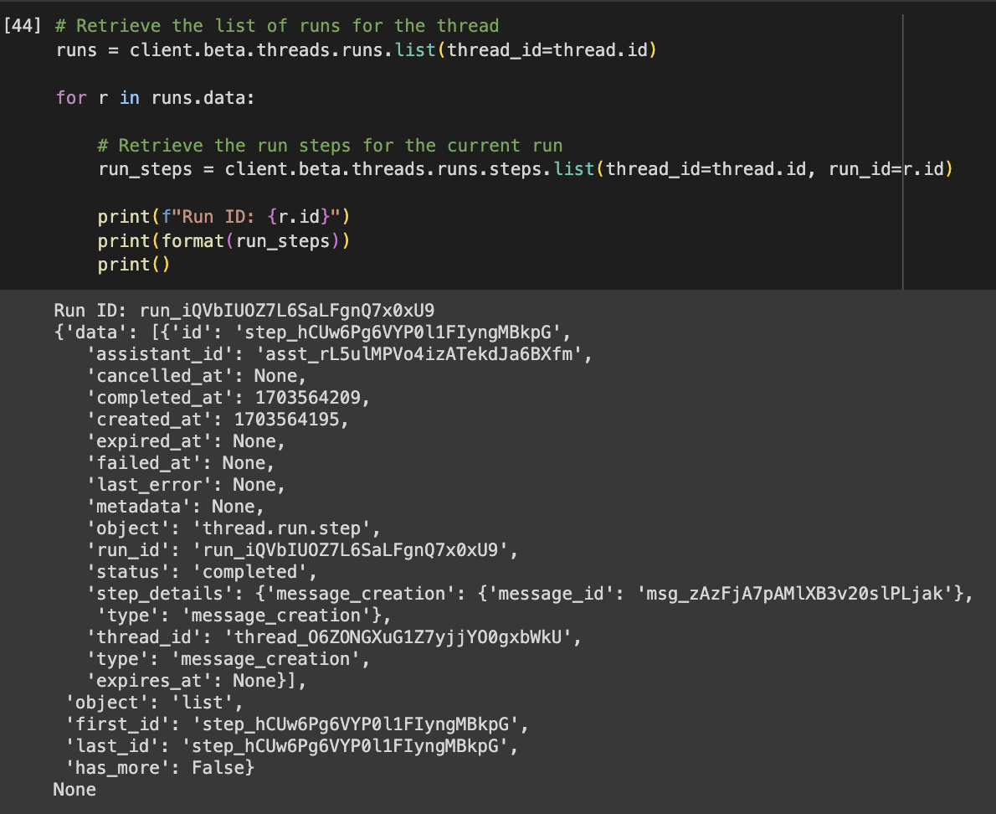
Run Step Object
Provides a detailed list of steps taken by the Assistant during its run.
Enables you to examine how the Assistant reached its final response
Notes:
Run Step Object
Provides a detailed list of steps taken by the Assistant during its run.
Enables you to examine how the Assistant reached its final response

Slide 20
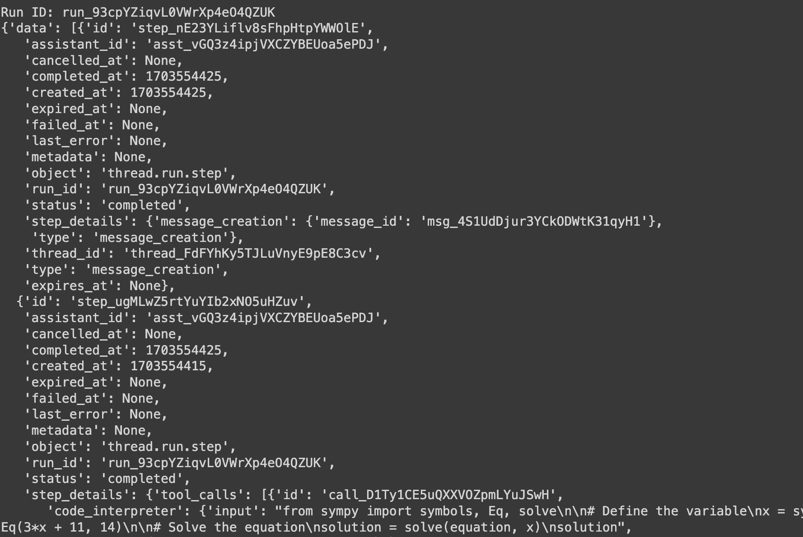
Run Step step_details
message_creation: Created when the Assistant creates a Message in the Thread
tool_calls: Created when a tool is called by the Assistant

Slide 21
Let’s Build with OpenAI Assistant API!
We’ll build a Math Tutor Assistant and a Research Assistant

Slide 22
Follow Along Here!
http://tinyurl.com/ZSL-openai-assistants-workshop

Slide 23
Hands-on Demo Time!

Slide 24
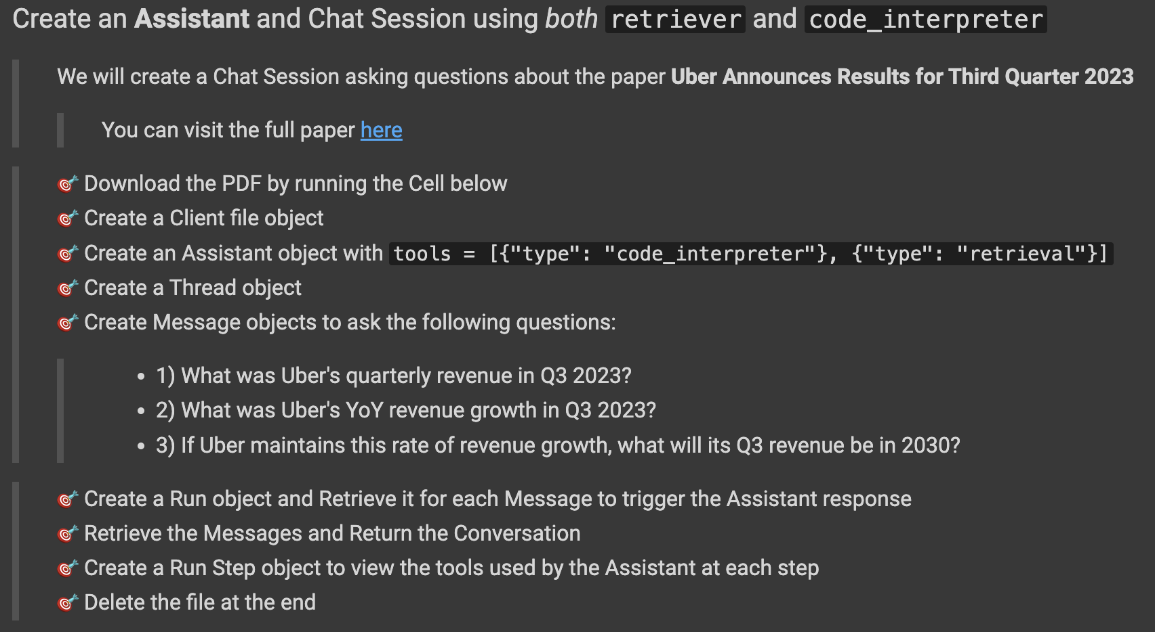
Final Exercise

Slide 25
http://tinyurl.com/ZSL-openai-assistants-workshop
File > “Save a copy in Drive”
Scroll down to the last cell
Fill in your solution!

Slide 26
Final Quiz

Slide 27
Final Quiz - Q1
Where do you define the Assistant tool(s)?
A. In a Thread Object
B. In a Message Object
C. In an Assistant Object
D. In a Run Object

Slide 28
Final Quiz - Q1
Where do you define the Assistant tool(s)?
A. In a Thread Object
B. In a Message Object
C. In an Assistant Object
D. In a Run Object

Slide 29
Final Quiz - Q2
What is the purpose of Threads in the context of Assistants?
A. Running Python code
B. Storing conversation sessions
C. Retrieving information from files
D. Describing custom functions

Slide 30
Final Quiz - Q2
What is the purpose of Threads in the context of Assistants?
A. Running Python code
B. Storing conversation sessions
C. Retrieving information from files
D. Describing custom functions

Slide 31
Final Quiz - Q3
Which Assistant Tool can be used to get the weather of a given location?
A. Code Interpreter
B. Knowledge Retriever
C. Custom Function

Slide 32
Final Quiz - Q3
Which Assistant Tool can be used to get the weather of a given location?
A. Code Interpreter
B. Knowledge Retriever
C. Custom Function

Slide 33
Final Quiz - Q4
What is the primary location for finding detailed information about a Run Step?
A. step_status
B. step_details
C. tool_calls
D. message_creation

Slide 34
Final Quiz - Q4
What is the primary location for finding detailed information about a Run Step?
A. step_status
B. step_details
C. tool_calls
D. message_creation

Slide 35
Final Quiz - Q5
How do we know when a run has completed?
A. It will generate an interrupt
B. We can poll the run status
C. It is guaranteed to finish within 1 second

Slide 36
Final Quiz - Q5
How do we know when a run has completed?
A. It will generate an interrupt
B. We can poll the run status
C. It is guaranteed to finish within 1 second

Slide 37
Final Quiz - Q6
Which is NOT benefit of using the Assistants API?
A. Efficient development
B. Personalized interactions
C. Automatically selects the best LLM for a given task
D. message_creation

Slide 38
Final Quiz - Q6
Which is NOT benefit of using the Assistants API?
A. Efficient development
B. Personalized interactions
C. Automatically selects the best LLM for a given task
D. message_creation

Slide 39
Final Quiz - Q7
Which of the following tools enables the Assistant’s API to run Python code in a sandboxed execution?
A. Code Interpreter
B. Knowledge Retriever
C. Custom Function

Slide 40
Final Quiz - Q7
Which of the following tools enables the Assistant’s API to run Python code in a sandboxed execution?
A. Code Interpreter
B. Knowledge Retriever
C. Custom Function

Slide 41
Wrap-up and Q&A
paul@zeroshotlabs.com

Slide 42
Thank You!
paul@zeroshotlabs.com

